Slide 1

Devasoorya Rejeesh
Nominee for Undergraduate Representative I Students’ Gymkhana 2020-21, IIT Hyderabad
Material Science and Metallurgical Engineering Sophomore
Indian Institute of Technology
Hyderabad

Slide 2
I, Devasoorya Rejeesh, a sophomore undergraduate from the department of Material Science and Metallurgical Engineering, if elected as a UG representative for the session 2020-2021 of Students’ Gymkhana - IITH, will work for the betterment of Undergraduates and Master of Sciences students in all possible fields.
The goals which I seek to achieve are not possible without your support. I am sure my agenda today, will convince you to support me.

Slide 3
CREDENTIALS
Creatives Coordinator - Elan & Nvision 2020, The Techno-Cultural Fest of IITH
Design Coordinator - Zozimus, The Literary Fest of IITH (2019-20)
Core Member - LitSoc, The Literary Society of IITH (2019-20)
Core Member - Gesture, The Arts Club of IITH (2019-20)
Core Member - Cepheid, The Astronomy and Astrophysics Club of IITH (2019-20)
Assistant Manager at E-Cell, The Entrepreneurship Cell of IITH (2018-19)
Active Member of Robotix, The Robotics Club of IITH (2019-20)
Active Member of the Freshers night (Newtella) organising committee (2019)
Volunteered for various domains in Elan & Nvision 2019

Slide 4
DUTIES
1. The UG Rep shall be the point of contact of all the Undergraduates for all the events happening with respect to the Undergraduates including:
Festivals and Events
Collection of entire record of batches corresponding to UG’s
Fresher and Farewell parties for all the Undergraduate batches
The UG Rep shall work along with the PG Rep on the matters listed in 1 (a), (b), (c).
The UG Rep shall work along with the General Secretary 1, General Secretary 2 on the matters related to hostel and catering issues.
The UG Rep shall try to bring out new initiatives along with the PG Rep and General Secretaries to increase the students’ participation and effectively reduce the UG-PG gap.

Slide 5
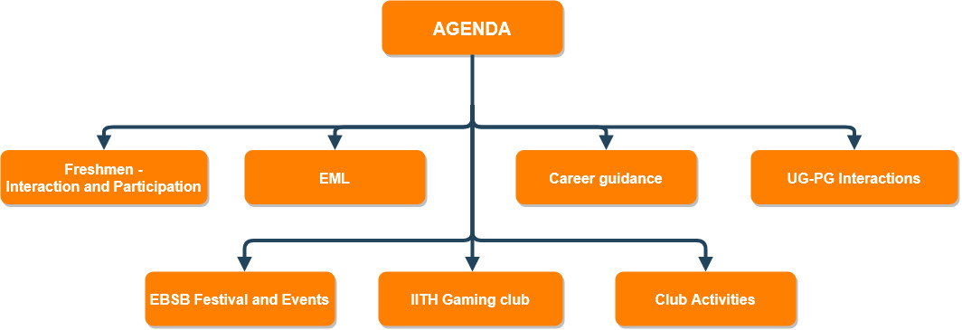

Slide 6
AGENDA
FRESHMEN - INTERACTION AND PARTICIPATION
Freshers’ forum discussion and interaction: An official facebook group will be created for the freshers which will contain a discord server link.
Considering the possibility of a complete online semester, the server would be maintained by a group of students.
This system would bring juniors and seniors together. Multiple channels can be set up for people with similar interests to join in and discuss various affairs such as sports, academics, movies,etc.
Keeping a keen eye on new and brimming talent amongst the freshers to identify and provide them with the resources and opportunities to bring laurels back home and make our college proud.

Slide 7
AGENDA
CAREER GUIDANCE
One session, annually, before the deadline of exam registrations will be conducted by a group of alumni, in association with the Alumni Cell.
Will help the students to broaden their career options.
A virtual database of the statistics on the jobs and internships offered by companies will be made.
Will have interviews of the hired students.
Will be done in accordance with OCS and Alumni Cell.

Slide 8
AGENDA
UG-PG INTERACTION
Departmental Day will be made a must.
Will be organized by students along with faculties.
Will help to promote interaction within the department, across all the years.
Also builds student faculty relationship.

Slide 9
AGENDA
INFORMAL CLUBS AND EVENTATHON
Informal clubs: Clubs for particular interests will be formed, starting with clubs for Anime and Meme.
More such clubs will be created when they have 25+ people showing interest and working together.
A parent club can also be associated if needed.
Online competitions: Eventathon to be conducted for actively engaging freshers in case the pandemic prolongs. This would be done in accordance with all the clubs.
Organised Planning: Scheduling meets and sessions of the clubs to avoid clashes, so that students can attend them conveniently.

Slide 10
AGENDA
IITH GAMING CLUB
A request that is long overdue and would grab the attention of a major chunk of students. All events related to gaming including indoor traditional games, tournaments, night-long sessions, game development etc. will be under the club.
Chess and Scrabble shall be set up in the first year under traditional games especially in the online mode. The inter-college competitions hosted by other IITs during the pandemic has showcased its popularity.
The growth of esports in recent years, and societal acceptance of video games as a legitimate profession has made video gaming a very popular recreation among students.

Slide 11
AGENDA
IITH GAMING CLUB (contd.)
The incorporation of online gaming tournaments as part of the Inter IIT fests seems to be on the horizon. Conducting competitions and informal sessions for popular titles such as CS:GO, DOTA 2, VALORANT etc, will be initiated.
Students who are interested to delve further into the technicalities of what makes a video game can come together to form the basis of game development.
Game dev is not a strictly coding-based activity but also lays emphasis on creative work.

Slide 12
AGENDA
EXTRA MURAL LECTURES
Students will be directly contacted to offer their preference on whom to call for EML sessions.
Thus giving the students their right for deciding the type and quality of content they want to digest.
Engaging students by conducting quizzes and giving goodies.

Slide 13
AGENDA
FESTIVALS AND EVENTS
EBSB: Ek Bharat Shreshtha Bharat along with various student communities will engage actively in celebrating various festivals of India.
Ensure maximum participation for all the events conducted.
Also contact the students for feedbacks and suggestions.

Slide 14
WITH THE TEAM
Online orientations will be planned together and executed without hiccups.
Shall take up the duty of a gymkhana member if he/she is unavailable.
I shall always be available to help the team accomplish their goals

Slide 15
MAY YOUR CHOICES REFLECT YOUR HOPES, NOT YOUR FEARS
- Nelson Mandela
THANK YOU
We now have a unique opportunity to use this crisis to do things differently and build a sustainable, resilient and inclusive tomorrow.
I pledge that I will put my maximum effort to achieve that.

